Slide 1
Presentation by
Evaluation of the flipped classroom
Karen
Henderson
Associate Professor in Technology Enhanced Learning
Associate Head of Department: Mathematics & Statistics
IMA workshop, UWE Bristol
21 March 2018

Slide 2
Plan of talk
Introduction to Flipping
Context
    Calculus & Numerical Methods Module
    Coding Theory & its Applications Module
Student monitoring + results (CNM)
Evaluation Methodology
Evaluation Results
Discussion

Slide 3
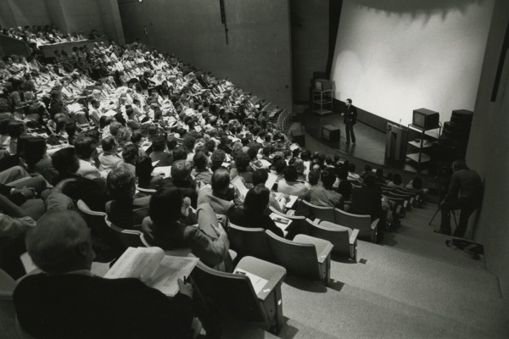


Traditional
Lecture + tutorial
  lecturer is in charge
Flipped
Learner-centred model
  Students work through/learn basics pre-class (reading/videos/e-Assessment)
  Class-time used for higher level skills
mid-fourteenth century
Mazur (1997) Peer Instruction: A user’s manual. Series in Educational Innovation. Prentice Hall

Slide 4
Context
Calculus & Numerical Methods (CNM)
Level 1 module taken by all first years (35-65 students)
Semester 1 taught in a traditional way
Semester 2 flipped since January 2015
Coding Theory and its Applications (CTA)
Optional Level 2 module (25-40 students)
Flipped since September 2013

Slide 5
Why change?
Always had good student feedback + marks on this module;
But … how much were our students learning … could they still remember techniques/methods in level 3?
Wanted students to have a deeper learning experience, to take control of their learning;
I had been keen to try this approach for a while
Attended an HEA workshop on “Lectures without lecturing” in Feb 2013;
Sat in on Catherine’s class in Oct 2014.

Slide 6

Pre-class (CTA):
Students advised to have access to text book (available electronically)
Study guide provided giving weekly reading, exercises and learning outcomes
Some short videos made available week by week

Slide 7
In-class (CTA):
Start 3 hour session with list of Learning Outcomes
Run short TurningPoint quiz (5-6 questions) to enable lecturer and students to diagnose their level of understanding.
Rough schedule of activities, adapted according to quiz results (in practice have a good idea of where problems will arise based on previous experience)
Mix of activities including active reading, group discussion, exercises from text book, student-created questions, students/tutor presenting solutions.
Tutor interacts with groups as appropriate to their progress
Regular breaks
Conclude with Learning Outcomes: light bulb moments!
Note: examination style altered to reflect approach.

Slide 8
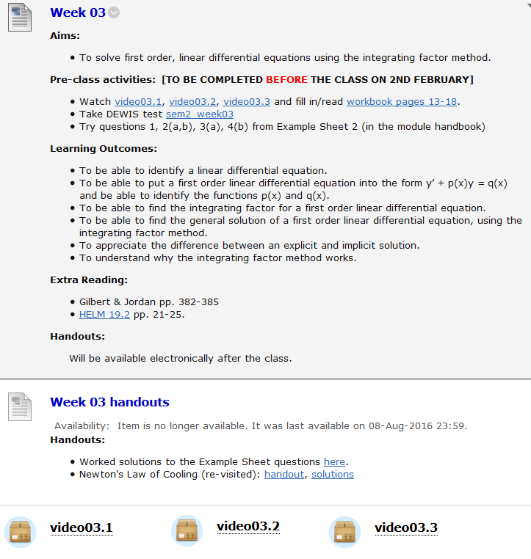
Pre-class (CNM):
Highly scaffolded approach:
Created a workbook (gapped lecture notes). For each week students had to:
Watch videos (typically 4, lasting a total of 40 mins)
Take a formative e-assessment (5 qns)
Try some basic questions from the worksheet
Optional extra reading/Maple file to download

Slide 9
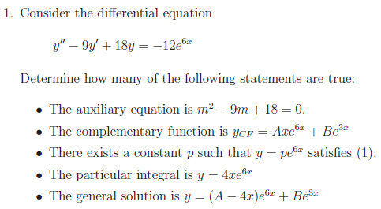
In-class (CNM):
Timetable: Two hour class each week + a support session every week
Start with TurningPoint
(typically 7 questions – takes
1 hour)
Worksheet qns (go round
group)
Sum up/go through
questions with the whole
group/do some Maple
Support session is optional – about 5 students.

Slide 10
Student monitoring (CNM)
Did they do the pre-work? (E-Assessment & video watching)
Attendance

Slide 11
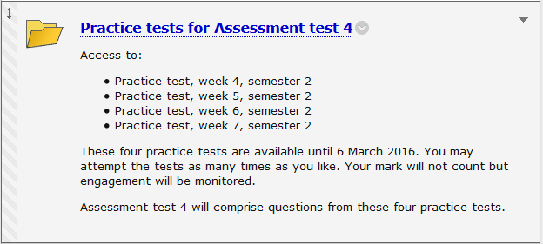
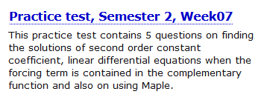
E-Assessment
Weekly formative online tests (typically 5 questions). As many attempts as they like. Only available outside summative assessment window (pre 2018).
Four summative e-Assessments through the module (max of 3 attempts at each – best mark counts) worth 30% of CW mark = 7.5% of overall module mark.

Slide 12
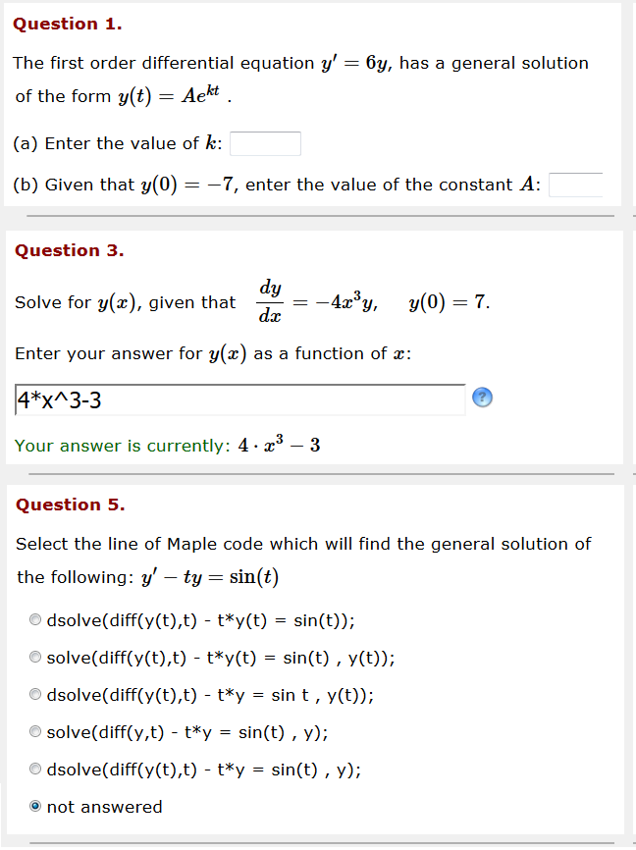
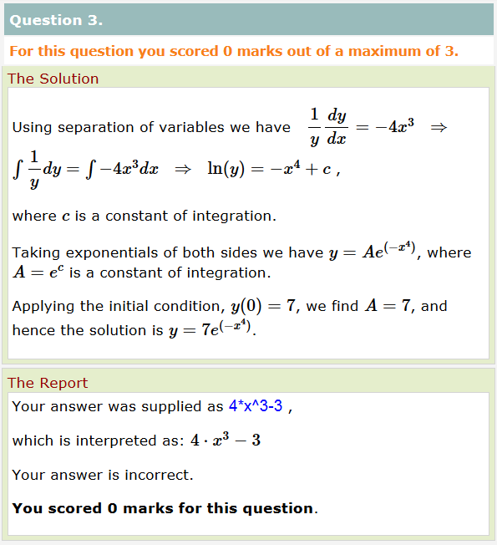
Sample Dewis questions
Random question parameters
Pre-submission checks
Bespoke feedback

Slide 13
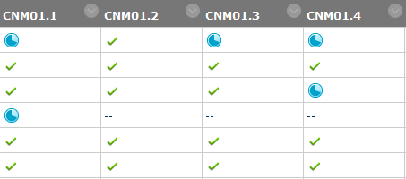
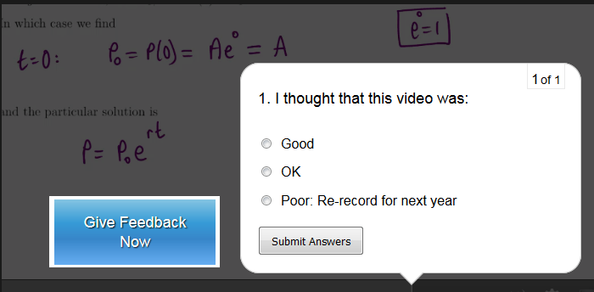
Videos
Monitored through SCORM completion on Blackboard.
Included a feedback quiz at the end of each one.

Slide 14
Student monitoring (CNM 2015/16)
Did they do the pre-work?
 | Watched 75% of weekly videos | Attempted Dewis practice test before class | Attempted Dewis practice test | Comments
Week 1 | 29 | 14 | 25 | Practice tests 1-3 contributed to assessment test 3
Week 2 | 31 | 11 | 22
Week 3 | 27 | 15 | 26
Week 4 | 24 | 1 | 15 | Practice tests 4-7 contributed to assessment test 4
Week 5 | 25 | 0 | 17
Week 6 | 21 | 8 | 17
Week 7 | 19 | 6 | 17
Week 8 | 19 | Report writing and group work - no Dewis test
Week 9 | 23 | 0 | 4 | Practice tests 9-10 did not contribute to a summative assessment
Week 10 | 17 | 4 | 7

Slide 15
Attendance (CNM 2015/16)
Average 27.6 per week (76.7% of “active” students).
Same as for Semester 1 (non flipped)

Slide 16
Exam results (CNM):
Exam and year | Number of attempts | Pass rate | Average Mark
2012-13 | 37 | 75.6% | 55.5
2013-14 | 65 | 66.1% | 45.8
2014-15 | 64 | 92.0% | 72.6
2015-16 | 36 | 88.9% | 71.0
2016-17 | 46 | 80.4% | 62.0
Changes from 2014/15:
Extra e-Assessment questions written to give better coverage of syllabus
Fortnightly/weekly online practice tests – engagement monitored
Flipped-style learning in Semester 2

Slide 17
Performance v. Engagement (CNM, 2015/16)
Attendance only
Videos only
Videos + attendance only

Slide 18
Evaluation Methodology
Methods for this summative evaluation took the form of focus groups and questionnaires
All students on the programmes were offered the opportunity to attend a focus group set at a time when there was no teaching on their timetable.
Focus groups were timed for the middle of the module run so students perceptions were not affected by assessment results.
5 from the CNM and 3 from the CTA cohort chose to attend
Students were also asked to complete a module evaluation on module completion.
The CTA students completed a pre and post module teaching (before assessment) questionnaire to gauge if there were any changes in their attitude towards learning.
There were 17 students that completed both questionnaires whose changes in attitudes could be analysed.
25 questions Likert scale – agree/disagree
Notes:
It is summative because the evaluation made no recommendations during the module of how it could be improved or reported before the module was completed on the students experiences. Results were used to develop the modules for the next cohort of students.
It is important to say that these modules were part of a larger study of which there were 3 other focus groups and 23 students were interviewed in total.
If anyone asks!!! Technically there was no control group but this questionnaire was used on two modules previously where the flipped classroom was NOT employed and the data was unusable because there was no discernible changes in students attitude to learning flowing the completion of the modules. So the fact that there is a discernible trend with the flipped classroom cohort implies it is the teaching style.
Overall there were 77 Q responses that were included in the larger study

Slide 19
Evaluation Results (CNM):
Had reservations due to previous flipping experience (school, college) but having experienced it at UWE they were dispelled and students in general felt it was a positive experience.
Having the workbook with the gaps means the students know which bits of knowledge are important for them to understand and they should pay attention to.
The students learn at their own pace
There is personalised interactions between them and the lecturer during class so they feel valued and can ask questions without the rest of the class overhearing (confidence – unlikely to ask questions in a lecture). This helps to build a relationship with the staff and gives a positive experience when new to university.
Still got something out of the session if they hadn’t done the pre-work (felt learning was no different to traditional style if they hadn’t!)
Notes:
Feel free to change the wording to bullet points/less wordy.
The filling in the gaps is important as a general complaint about the flipped classroom is that students don’t know what they don’t know!!!!

Slide 20
66.7% agreed that they liked the flipped style of teaching and would like to experience this style of teaching in their level two modules whilst just 7% disagreed.
Finding the time/remembering to do the pre-work was the most common response to the question "the worst thing about being taught in this way".
Some of the responses to the question "the best thing about being taught this way was" are reproduced below:
Having the information consolidated in the lecture
Made the most of our time with the expert ... Best value for money
Encouraged more independent learning and extra reading
Already knowing something before the lecture
A chance to work though problems at our own pace
Just over an hour on pre-class work per week.

Slide 21
Evaluation Results (CTA):
Overall positive feedback from questionnaires and focus groups
Students commented that they preferred this mode: not always playing catch-up
Pre-class materials not as extensive as CNM but students have matured by this point - this was not highlighted as an issue.
Requested some video input rather than just purely reading, which has since been implemented
Attendance in class good throughout term.
Very few failures – engagement with material high.

Slide 22
Following completion of the module the students were more likely to agree with the statements:
I feel comfortable raising questions with staff about what I am learning
I am responsible for my learning
I use feedback on my work to improve in the future
I feel confident contributing to seminars
They were more likely to disagree with the statements:
When I find learning too challenging I give up
I prefer to follow other people’s ideas than develop my own
I do not like it when I find learning challenging

Slide 23

Discussion
Student feedback has been positive.
Emphasising the benefits and value of the approach at the start of each module has been key to engaging students.
Important to convey our expectation that students have to work in advance.
Module performance is strongly correlated to engagement and attendance.
Is a teaching style isn't necessarily suitable for all teaching occasions but that it is something that could be considered.
Both modules are relatively small – different approach for larger classes?
How to get more discussion/working together in class (TEAL space)

Slide 24
Case for alternatives to traditional lectures:
Freeman et al. (2014) examined 225 studies that compared student
achievement in a range of undergraduate STEM courses and found that students in lecture-oriented classes were 1.5 times more likely to fail than were students in inquiry-oriented classes.
A provocative conclusion
“If the experiments analysed here had been conducted as randomised
controlled trials of medical interventions, they may have been stopped for benefit—meaning that enrolling patients in the control condition might be discontinued because the treatment being tested was clearly more beneficial.”
Freeman et al. (2014) Active learning increases student performance in
science, engineering, and mathematics. Proc. Nat. Acad. Sci. U.S.A. 111 (23) pp 8410-8415
http://www.changinghighereducation.com/2014/06/are-lectures-detrimental-to-student-learning.html

